Slide 1
The Blues
Blues evolved and no one single person is credited with its invention.
Musicologist credit Charlie (Charley) Patton as the first known blues artist

Slide 2
Charlie Patton

Slide 3
Home of the Blues
Charlie Patton lived and worked at the Home of the Blues, The Dockery Plantation in the Mississippi Delta.
Charlie Patton played a form of blues that was known as Delta Blues, most Delta Blues are just guitar and vocals.

Slide 4
The Blues begins to travel
With the success of early blues artist, the blues will begin to spread to other parts of the rural south and across the country developing different regional styles and stars
Early Blues was viewed by the white community as not good music, by not good musicians. (not written down)

Slide 5
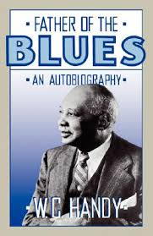
The Father of the Blues
Father of the Blues, W.C. Handy
Because he is the first to write it down

Slide 6
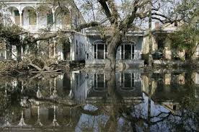
The Roots of Jazz
12 Bar blues is first played on instruments in New Orleans, becoming an instrumental music, no just vocal music. This will help lead to the development of Jazz

Slide 7
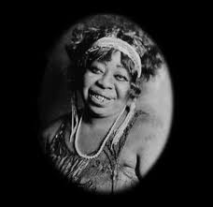
The Mother of the Blues
Ma Rainey is the Mother of the blues
Down Home Blues, songs about life in the rural south

Slide 8
Race Records
Race records, records by black artist for black listener
The Blues continue to evolve becoming more complex

Slide 9
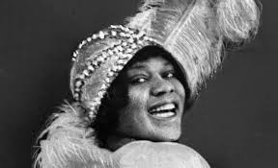
Bessie Smith
Bessie Smith, the Empress of the Blues
Up Town blues. Songs about a more urban life style

Slide 10
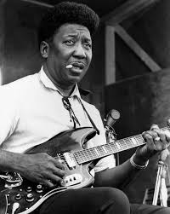
Muddy Waters
Muddy Waters is the first to create the all electric blues band in Chicago in the 1950’s recording at Chess records

Slide 11
Blues Listening List
Sweet Home Chicago Robert Johnson Delta Blues
Preacher Blues Son House Delta Blues
Spoonful Blues Charlie Patton Delta Blues
Bo- Weavil Blues Ma Rainey Down Home Blues Bring it on Home Sonny Boy Williamson Modern Blues
High Society T Bone Walker Blues/Texas One String
Back Water Blues Bessie Smith Up Town Blues
I Don't Want Muddy Waters Electric Blues
Sweet Little Angel BB King Electric Blues
Mannish Boy Muddy Waters Electric Blues
The Thrill is Gone B.B. King Electric Blues

