Slide 1
Dedicated to Chaos
Minton’s Playhouse in NYC
Young bored musicians gathered on Monday nights to Jam and experiment with the music pushing it in a new direction
Playing for their on pleasure
Dizzy Gillespie, T.Monk, Kenny Clark and others
Slowly developing a fan base

Slide 2
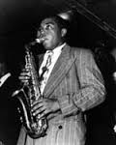
Charlie “The Bird”Parker
Great inventive musician, developments a new way of soloing based on the chords not the melody.
Started off as a KC blues musician

Slide 3
Charlie Parker
Has a twin legacy, Great Talent & Drug addicition
Developments a drug problem at a young age
With Dizzy Gillespie he will be a leading figure in the Be-Bop
He will never receive much fame outside the jazz world
He dies young after year of drug abuse
Left much unfinished

Slide 4
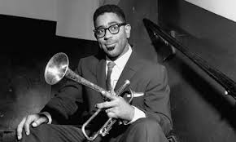
Dizzy Gillespie
One of the founding members at Minton’s
Develops a style of trumpet playing
A great teacher of the new style

Slide 5
Dizzy Gillespie
Worked with Parker developing the new style
Be-Bop
Will be the leading spokesman for Be-Bop
Lives a long and productive life

Slide 6
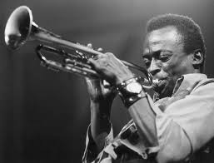
Miles Davis
From St Louis Mo.
Grew up in a wealthy black family

Slide 7
Miles Davis
1st played with Parker & Gillespie @ 15
Full time musician with Parker @ 19
Founding member of the Cool Style of Jazz
Will struggle with drugs all his adult life
The leading figure in Jazz for 60’s ,70’s &80’s
Will help create other new styles of Jazz

Slide 8
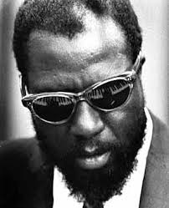
T.Monk
Founding member at Minton’s
Composer and pianist

Slide 9
T.Monk
Strange personality
Lost his cabaret card, and refused to leave NYC for work
1st panned by the credits and the fans to only latter be hailed a star!
Took jazz in new directions
Epistrophy

Slide 10
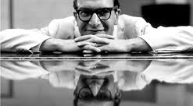
Dave Brubeck
The leading figure is the West Coast Jazz style (cool)
Composer and Pianist
Long and successful career
Used new and different ideas in jazz
Take Five

Slide 11
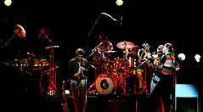
Weather Report Birdland

Slide 12
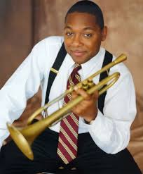
Winton Marsalis 10/61- Soon all will Know

Slide 13
Louis Armstrong Hello Dolly

