Slide 1
Louis Armstrong
Busted for pot in 1930
Meets his 2nd wife Lil Hardin pianist in Joe King’s Band
Married 4 time, enjoyed the young women
On the run form Chicago organized crime for four years
Joe Glazer his manager
One of the 1st black artist in major Hollywood movies
1st black on a nationally sponsored radio show
Good will Ambassador for U.S. around the world
Very generous with his money
Active in Civil Rights issues is whole life
Investigated by the FBI from the 50’s on
1st heart attack in 59

Slide 2
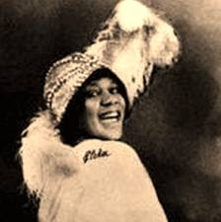
Bessie Smith The Empress of the Blues
One of the most popular Jazz/Blues singers of the 20’s
Learn to sing from “Ma” Rainey
Lived life in the fast lane
Died in a car crash

Slide 3
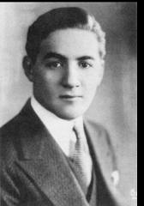
Young Benny Goodman
Born in Chicago to poor Russian Jewish parent
1 of 9 children
Grew up very poor
Showed great musical talent at a very young age (Clarinet)
Became a professional musician at age 12
Moved to Ca. to play in Ben Pollack’s band at 16

Slide 4
Young Benny Goodman
As a professional musician Benny earned enough to support the family
David Goodman (Benny’s father) is killed when hit by a truck never having seen his son play in a professional band
Benny Goodman is driven to be the best and never wants to be poor again

Slide 5
The Cotton Club
Harlem’s most famous club (speakeasy)
White patrons only
Duke Ellington’s new Manager gets Duke an audition for the owners of the club
Irving Mills is now Duke’s manager
Duke gets the gig in 1927
Broadcast live on the radio from the Cotton Club, gaining a new national audience

Slide 6
Cotton Club
Appeared in movies as he was, Classy
Always a role model for his people
Always musically ahead of the crowd!
Had some of the best black musicians in his band

