Slide 1
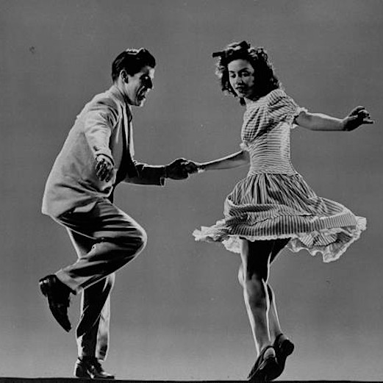
Swing: Pure Pleasure

Slide 2
Introduction
The stigma around Jazz began to change and people were beginning to view it as an elegant, sophisticated dance music
Swing saved the recording industry from financial ruins during the Great Depression
Whites who had never heard jazz before began to crowed ballrooms to try to forget about hard times.
The ‘Lindy Hop’ became the ‘Jitterbug’

Slide 3
The New Deal
The New Deal was a series of domestic programs developed United States between 1933 and 1936
They included both laws passed by Congress as well as presidential executive orders during the first term (1933–37) of President Roosevelt.
The programs were in response to the economy and focused on what historians call the "3 Rs":
Relief, Recovery, Reform
That is Relief for the unemployed and poor; Recovery of the economy to normal levels; and Reform of the financial system to prevent a repeat depression

Slide 4
Swing
Benny Goodman became, ‘The King of Swing’
Did not give himself the title
Goodman’s 2-week residency at New York’s Paramount Theatre served as an announcement that jazz had moved from cult to pop status
Jazz is no longer ‘race’ music
Musicians continued to integrate but segregation continued to stop them from performing together

Slide 5
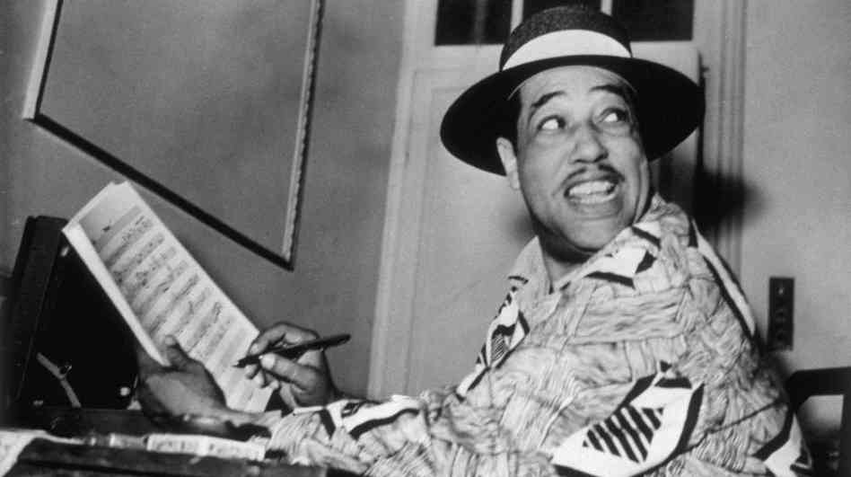
Dreaming
Ellington did not dwell on the popularity of white musicians
Ellington continues on his own course
Ellington did not like the racism going and instead of voicing his opinion to the public, he wrote some Blues

Slide 6
Where’s Armstrong?
Armstrong hires a new manager to try and save his career
He hires, Joe Glaser who worked tirelessly on his behalf
Armstrong began an acting career, cast as a stereotypical black man
But his powerful presence and charisma broke the chains of old-fashioned racist beliefs
Most people don’t realize how essential he is to jazz

Slide 7
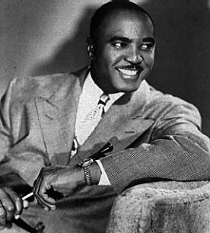
Jimmie Lunceford
Wonderful stage presence was expected
Crowed engaging
Had fine soloists but his band’s precision lured people to he dance floor
Looked sharp
They had visual routines that made the band very entertaining to watch
The band was always ‘at it’s peak’

Slide 8
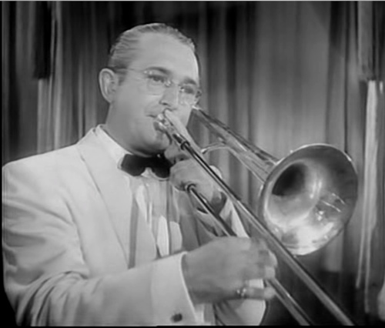
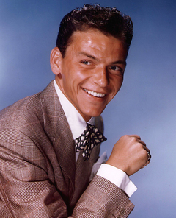
Tommy Dorsey
Trombone player- with a new sound & changed the way people viewed the trombone
Was referred to as the ‘Sentimental Gentleman of Swing’
Dorsey was a ‘tight fisted’ task master
His band was hugely popular
Frank Sinatra had his start in Tommy Dorsey’s band
His band was stylistically diverse and could play both in the jazz and pop idioms

Slide 9
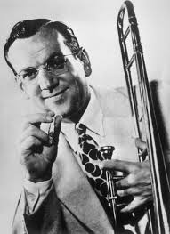
GLENN MILLER
Trombone Player
Favored tightly controlled arrangements, plenty of vocals, and showmanship
He popularized swing music for people who didn’t respond to Goodman and Ellington’s music
Produced many hits that became some of Swing’s most iconic charts

Slide 10
Artie Shaw: ‘The Business Part’
ARTIE SHAW: Great clarinetist and Benny Goodman’s greatest rival
He successfully combined chamber music with jazz
Had a hard time processing and dealing with fame; ‘Nothing in life can prepare you for stardom’
‘Popular music has little to nothing to do with musical values’
by 1939 his popularity surpassed that of Benny Goodman, but eventually called off his musical career because he did not enjoy the business part of the industry

Slide 11
Bands on ‘The Road’
Swing music has become a multi-million dollar industry
30,000-40,000 swing musicians are employed by 1937 plus another 8,000 needed to manage these musicians
Until their union gained them better working conditions, musicians played 7 days per week with up to 500 miles between gigs
The road was a dangerous place for black musicians because of segregation
If it wasn’t for the hospitality of the black communities, black musicians may not have been able to survive on tour

Slide 12
‘Like Taking a Drug’
While adults are now beginning to enjoy jazz music, it was teenagers who made jazz ‘a national craze’
Bandleaders become celebrities and even had their own fan clubs
Both Artie Shaw and Benny Goodman agree that this obsession made them uncomfortable and felt that at times there was too much enthusiasm
Some critics referred to swing music as ‘orchestrated sex’ and also believed that the music acted like a narcotic in that it made young people forget about reality

Slide 13
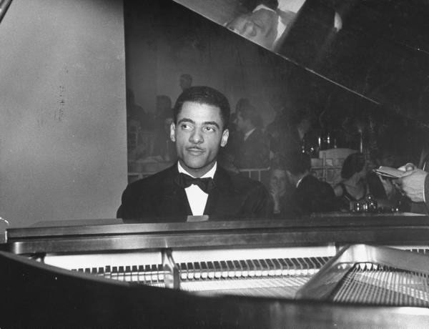
Teddy Wilson
-Teddy Wilson met Benny Goodman at a jam session in 1934
-Within weeks of their meeting they were recording records together
-Benny Goodman was hesitant to perform on stage with Wilson because Wilson was a black man and Goodman didn’t want to ruin his career in tough times
-Eventually, Goodman was talked into performing with Wilson on stage
-After a successful run of live performances with Wilson , Goodman sought after more talented black musicians and eventually hired, Lionel Hampton
-Few other bandleaders followed Goodman’s lead

