Slide 1
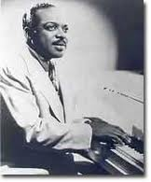
Count Basie

Slide 2
Count Basie
Piano player from New Jersey
Learned to play from the stride masters
His band ran out of money and was stranded in KC
Started playing in local KC clubs
Excited by the KC sound
Forms his own group/Count Basie & His Barons of Rhythm
Develops a style of only playing a few well placed notes

Slide 3
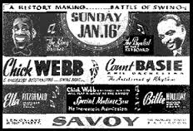
Count Basie
Goes to NYC with John Hammond
Hammond want Basie’s band to gets bigger
Now 12 musicians
Bombs is first NYC gig at Roseland
Tours with the band for 18 months
Returns to face Chick Webb @ the Savoy 1/16/1938
And the winner is?

Slide 4
Count Basie
John Hammond pays to have A.C installed at the Famous Door in the summer of 1938 in return for Count Basie’s band being booked to play their that summer.
Sound of KC helps bring new life into Swing!

Slide 5
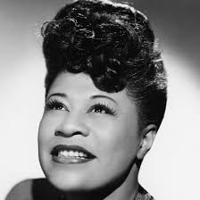
Ella Fitzgerald
Born poor
Troubled Childhood

Slide 6
Ella
Won the Apollo Theatre amateur contest, but was to booked to play becauses of her looks
Charles Linton a singer in Chick Webb’s band want to hire Ella, but Chick says no because of Ella’s looks
Chick agrees to hired Ella
With Ella Chick becomes a national star
Chick Webbs dies
Ella takes over the Band,Ella Fitzgerald and her Famous Orchestra

Slide 7
Billie Holiday
Billie will join at different times both Count Basie’s band, an then Artie Shaw’s
Life is difficult for Billie in both bands
Develops a life long musical friendship with Lester Young from Basie’ band
Lives life on the edge, has troubled relationships and with the law
Finds a home in the clubs on 52nd St. NYC

