Slide 1
The Great Depression 1929-
25% of all white workers are unemployed
More the 50 % unemployment in the black community
Record sales dropped from 100 million in the late 20’s to about 6 million
Hard Times for most musicians
Louis Armstrong and Duke Ellington’s fame continues to grow

Slide 2
Armstrong returns to NYC
Louis Armstrong is booked by his new manager Tommy Rockwell to play at Connie’s Inn, a mob owned club
Armstrong is making many new records and singing on most!

Slide 3
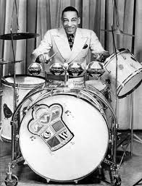
Chick Webb
Leader and drummer of the house band at the Savoy Ballroom in Harlem
The Savoy is one of Harlem hottest spots for the new developing style of jazz “Swing”
The popular dance of the day was the Lindy Hop
Swing was music for dancing
Not yet a national craze!

Slide 4
Armstrong Busted
Louis Armstrong is arrested in L.A.
Johnny Collins is sent by Rockwell to get him out of jail
Johnny Collins tells Armstrong that he is now his new manager, with is not true!
Collins books Armstrong to play in New Orleans, and he receives a heroes welcome

Slide 5
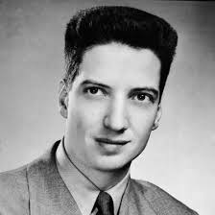
John Hammond
Great grand son of Cornelius Vanderbilt
Grew up in wealth!!!!!!
Falls in love with Jazz
Drops out of Yale and begins a career writing about Jazz
As a form of social protest he starts using he own money to advance the careers of many unknown artist

Slide 6
Benny Goodman
Benny Goodman goes to NYC after being fired by Ben Pollack
Successful studio musician
Listening to all types of jazz in NYC
Forms an all white band for a gig at a new legal club Billy Rose’s
Hired to play on a live 3 hour radio show Let’s Dance

Slide 7
Let’s Dance
Benny’s band needs more music for Let’s Dance, John Hammond arranges for Goodman to buy music from Fletcher Henderson
Let’s Dance is cancelled when the sponsor pulls the plug
Goodman heads out on a cross country tour that does not go well
Fans are waiting for him in L.A. at the Paloma Ballroom

Slide 8
Louis Armstrong
In 1933 Armstrong enjoys a triumphant tour of Europe
Break ties with his abusive manager Johnny Collins
Reluctant to return to the USA
Takes an 8 month retirement in Paris
Has a difficult time finding work upon his return

