Slide 1
The Classical Period 1750-1825
Emphasis on formal structure, including the sonata form
Greek and Roman aesthetic principles of beauty
Balance, symmentry of formal design, and clarity and refinement

Slide 2
The Classical Period 1750-1825
The Classical orchestra grows bigger with new instruments
The role of the conductor become more important/ no harpsichord
Everything is now written out, no figured bass
The textures for mostly homophonic

Slide 3
The Sonata Form
Introduction
First Theme or A melody
Transition/bridge
Second Theme or B melody
Transition/bridge
Closing Theme or C melody
Development (B melody)
Recapitulation-Reprise (A melody)

Slide 4
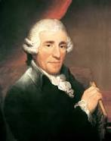
Franz Joseph Haydn 1732-1809

Slide 5
Franz Joseph Haydn 1732-1809
Born in Austrian 3/31/32
Father of the Symphony (Wrote 104)
Father of the String Quartet
Spend many years as court musician & composer for the Esterhazy family
Friend and mentor to Mozart
Mentor/teacher of Beethoven

Slide 6
Franz Joseph Haydn 1732-1809
His parents where common folk
Dad was a self taught folk musician
Parents discover the Franz had a musical talent and sent he off at age 6 for training, never to return home.

Slide 7
London Symphony #104 in Dmajor 1st mvt.
Sound Source: Classical Orchestra
Concept:Showing off Sonata form
Behavior: Listening
Texture:Homophonic
Meter:Duple
Tempo:Largo & Allegro
Form: Sonata form

Slide 8
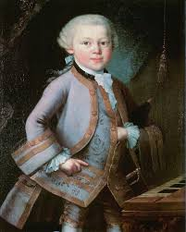
Wolfgang Amadeus Mozart 1756-1791

Slide 9
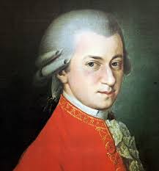
Wolfgang Amadeus Mozart 1756-1791

Slide 10
Wolfgang Amadeus Mozart 1756-1791
Born in Salzburg Austrian
Son of a well known musician/composer
Leopold Mozart
Child prodigy
Toured Europe with father and sister performing
Wrote his first compositions at 4 or 5

Slide 11
Symphony # 41 “Jupiter” Mozart
Sound Source: Classical Orchestra
Concept:Showing off Sonata form
Behavior: Listening
Texture:Homophonic
Meter:Duple
Tempo: Allegro
Form: Sonata form

Slide 12
12 Variations for Piano Mozart
Sound Source: Piano
Concept:Exploring different variations
Behavior: Listening
Texture:Homophonic&Polyphonic
Meter:Varied
Tempo:Varied
Form: Through Composed, Theme & Variation

Slide 13
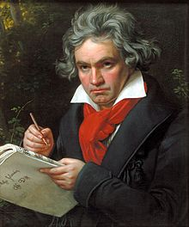
Ludwig Van Beethoven 1770-1827

Slide 14
Ludwig Van Beethoven

