Slide 1
Unit 4
Time
Rhythm
&
Meter

Slide 2
Terms
Beat/Pulse: is a counting unit, a measure of time
Meter: is a regular beat pattern of accented and unaccented beats
Symmetric Meters: are Duple and Triple meters and their multiples
Duple Meter: a beat pattern in groups of two
Triple Meter: a beat pattern in groups of three

Slide 3
terms
Asymmetric Meters: are “odd number” meters ( such as 5 ,7,or 9 beats per measure)
Rhythm: a specific “ time pattern” or module in music, How we divide up the beat or time
Non-Metric Music:is music which does not have any regular beat structures or counting patterns

Slide 4
Tempo
Tempo: the speed of the beat
Tempo markings
Grave: very slow
Largo:slow
Andante: medium slow
Moderato: medium
Allegro: Fast
Presto Very Fast

Slide 5
La Donna e mobile
Sound Source: Male voice & orchestra
Concept:Telling a story about a woman
Behavior: listening and watching
Form: Binary AAB
Texture: Homophonic
Mete:rTriple
Tempo: Presto

Slide 6
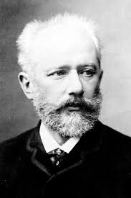
Peter Ilich Tchaikovsky 1840-1893

Slide 7
Trepak
Sound Source: Symphony Orchestra
Concept: Ballet, telling of a story
Behavior: Dancing & watching
Form: Ternary AABA
Texture: Homophonic
Meter: Duple
Tempo:Allegro-Presto

Slide 8
Heidenroslein Franz Schubert
Sound Source: Piano and Soprano voice
Concept: Love Song & Story
Behavior: Listening
Form: Through Composed-One part
Texture: Homophonic
Meter: Duple
Tempo: Andante

Slide 9
The Little Rose on the heath
A young lad saw a rosebud, rosebud on the heath
It was young and lovely as the dawn
That he ran quickly to see it more closely; he saw it with great joy
Rosebud,rosebud,reosebud red, Rosebud on the heath

Slide 10
The Little Rose on the heath
Said the youth”I’ll pick you, rosebud on the heath”
The rosebud said, “I’ll prick you, so you will always think of me, and I’ll not suffer this”
Rosebud,rosebud,rosebud red, Rosebud on the heath

Slide 11
The Little Rose on the heath
And the wild lad plucked the rosebud on the heath.
The rosebud defended itself and pricked him, but no moans or sighs helped it,
It simply had to suffer
Rosebud,rosebud,rosebud red, Rosebud on the heath

Slide 12
Elegant Music-Gagaku
Sound Source: Ancient Japanese Instruments
Concept: Music for Royalty
Behavior: Listening and Watching
Form:Unknown
Texture: heterphonic
Meter:Unknown
Tempo:Unknown

Slide 13
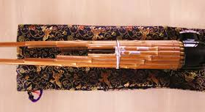

Slide 14
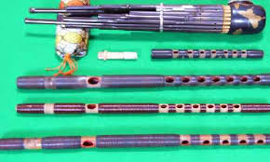

Slide 15
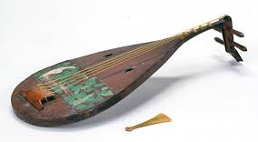

Slide 16
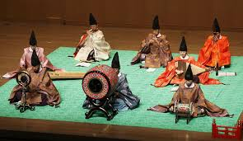

Slide 17
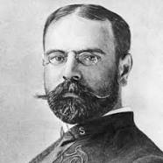
John Phillip Sousa The March King 1854-1932

Slide 18
John Phillip Sousa
His father enlisted him in the Marine Corp Band in 1868
Left the Marine Band after the band he learned to be a conductor and composer
Rejoined the Marine Corp Band for a second, this time has in Conductor
Composed many of his most famous marches for the Marine Band

Slide 19
John Phillip Sousa
Left the Marine Corp band after 12 years to start his own very successful band.
Tour across the USA and Europe
One of America’s first musical super stars
Made some of the first recordings
Died a national hero in 1932

Slide 20
Hands a Cross the Sea John Phillip Sousa
Sound Source:Concert Band
Concept: Expression of patriotism
Behavior: Marching, Listening
Form: Intro-Through Composed Trio ABC
Texture:Homophonic
Meter:duple
Tempo:Allegro

Slide 21
Tsone Mile Chedo
Sound Source: Drums,Bagpipes, Strings, Kavals
ConceptFolk Dancing:
Behavior: Dancing
Form: Binary
Texture:Homphonic
Meter:Asymmetric 7/8 (2-2-3)
Tempo: Allegro

Slide 22
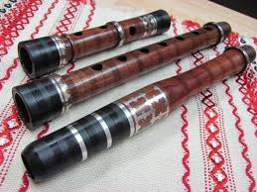
Kavals

Slide 23
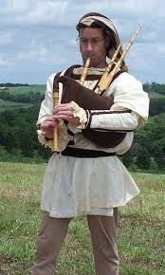
Bagpipes

Slide 24
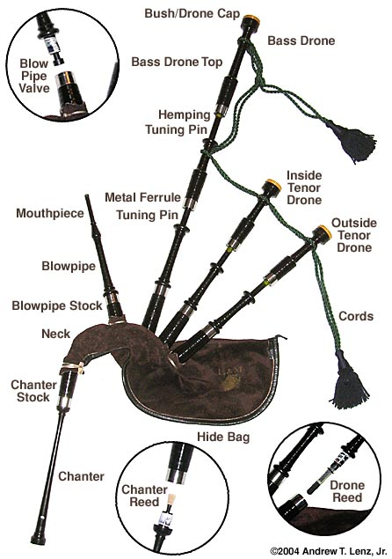
Bagpipes

Slide 25
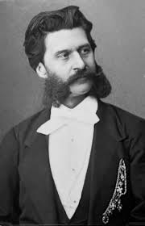
Johann Strauss II 1825-1899 The Waltz King

Slide 26
Johann Strauss

