Slide 1
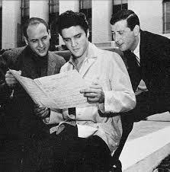
Be My Baby
Jerry Lieber and Mike Stoller
Influential songwriters and procducers of the 50’S& 60’s
Helped make R&R a more refined style

Slide 2
Jerry Lieber and Mike Stoller
Worked with the most important artists of the late 50’s and early 60’s
Elvis,Ben E King, The Coasters…….
Developed what was called “Sweet Soul”
First important R&R producers
Added instruments not used before in R&R

Slide 3
The Producer
With the invention of Multi Trak recording the role of the producers becomes more important
The Producer has the final say on what the recording will be!!!!
Most new artist do not produce their own music

Slide 4
Carole King & Gerry Goffin
Song writing team
Wrote hits for several girl groups in the early 60’
First big hit was Will you still Love Me by the Shirelles
Carole King will have a solo career in the 70’s

Slide 5
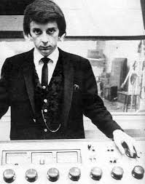
Phil Spector
A R&R super producer/songwriter
Developed the girl group sound of the 60’s
Spector becomes the star and the artist was secondary

Slide 6
Phil Spector
The Wall of Sound
Many instruments packed to one small studio
2 or 3 of each instrument all playing the same thing
The Wall of Sound was Spector’s early trade mark sound
Phil Spector will work with many different artist of the years
Currently serving 25 to life for murder!

Slide 7
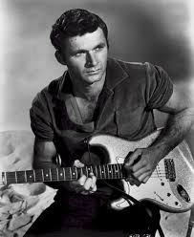
Dick Dale
King of the Surf guitar
Many regional hits
Combined Middle Eastern melodies with a rhythmic guitar style

Slide 8
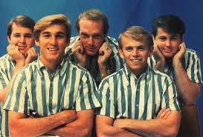
The Beach Boys
First called the Pendeltones then the Beach Boys
A family affair Brian, Dennis and Carl Wilson,Mike Love and Al Jardine

Slide 9
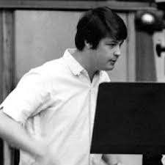
Brian Wilson
First rock artist to write, perform and produce his own music
Inspired by Phil Spector

Slide 10
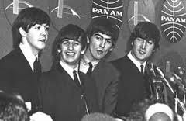
2/7/64
The rock and roll went back to basics

