Slide 1
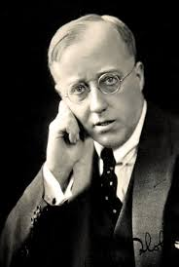
Gustav Holst 1874-1934

Slide 2
The Planets
Written in 1914-16, during a low point in Holst’s in his musical life.
Mars, The Bringer of War
Venus, the Bringer of Peace
Mercury, The Winged Messenger
Jupiter, The Bringer of Jollity
Saturn, The Bringer of Old Age
Uranus, The Magician
Neptune, The Mystic

Slide 3
The Planets
Sound Source: Full SymphonyOrchestra
Concept: Telling Story
Behavior: Listening & Enjoying
Form
Texture: Homophonic
Meter: Duple
Tempo: Allegro

Slide 4
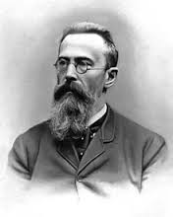
Nikolai Rimsky-Korsakov 1844-1908

Slide 5
Scheherazade 1888 One Thousand and One Nights
Sound Source:Full Orchestra & Violin Soloist
Concept: Telling Story
Behavior: Listening &Enjoyment
Form
Texture:Homophonic
Meter: Compounded Duple
Tempo: Varied

Slide 6
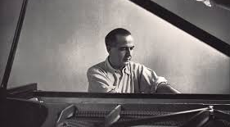
Samuel Barber 1910-1981

Slide 7
Adagio for Strings 1938
Sound Source:String Orchestra
Concept: Raw Emotions
Behavior: Listening & Enjoyment?
Form:Arch form
Texture:Homophonic
Meter:Duple
Tempo:Adagio

