Slide 1
The Gift

Slide 2
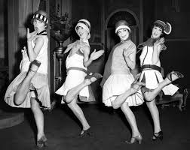
The Jazz Age
The Jazz Age, the 1920’s
The economy in the USA was strong
Jazz will find new homes
Chicago and New York City (Time Sq & Harlem)
Jazz has become America’ s pop music & Soundtrack to the world around them
Loved by young people not their parents!

Slide 3
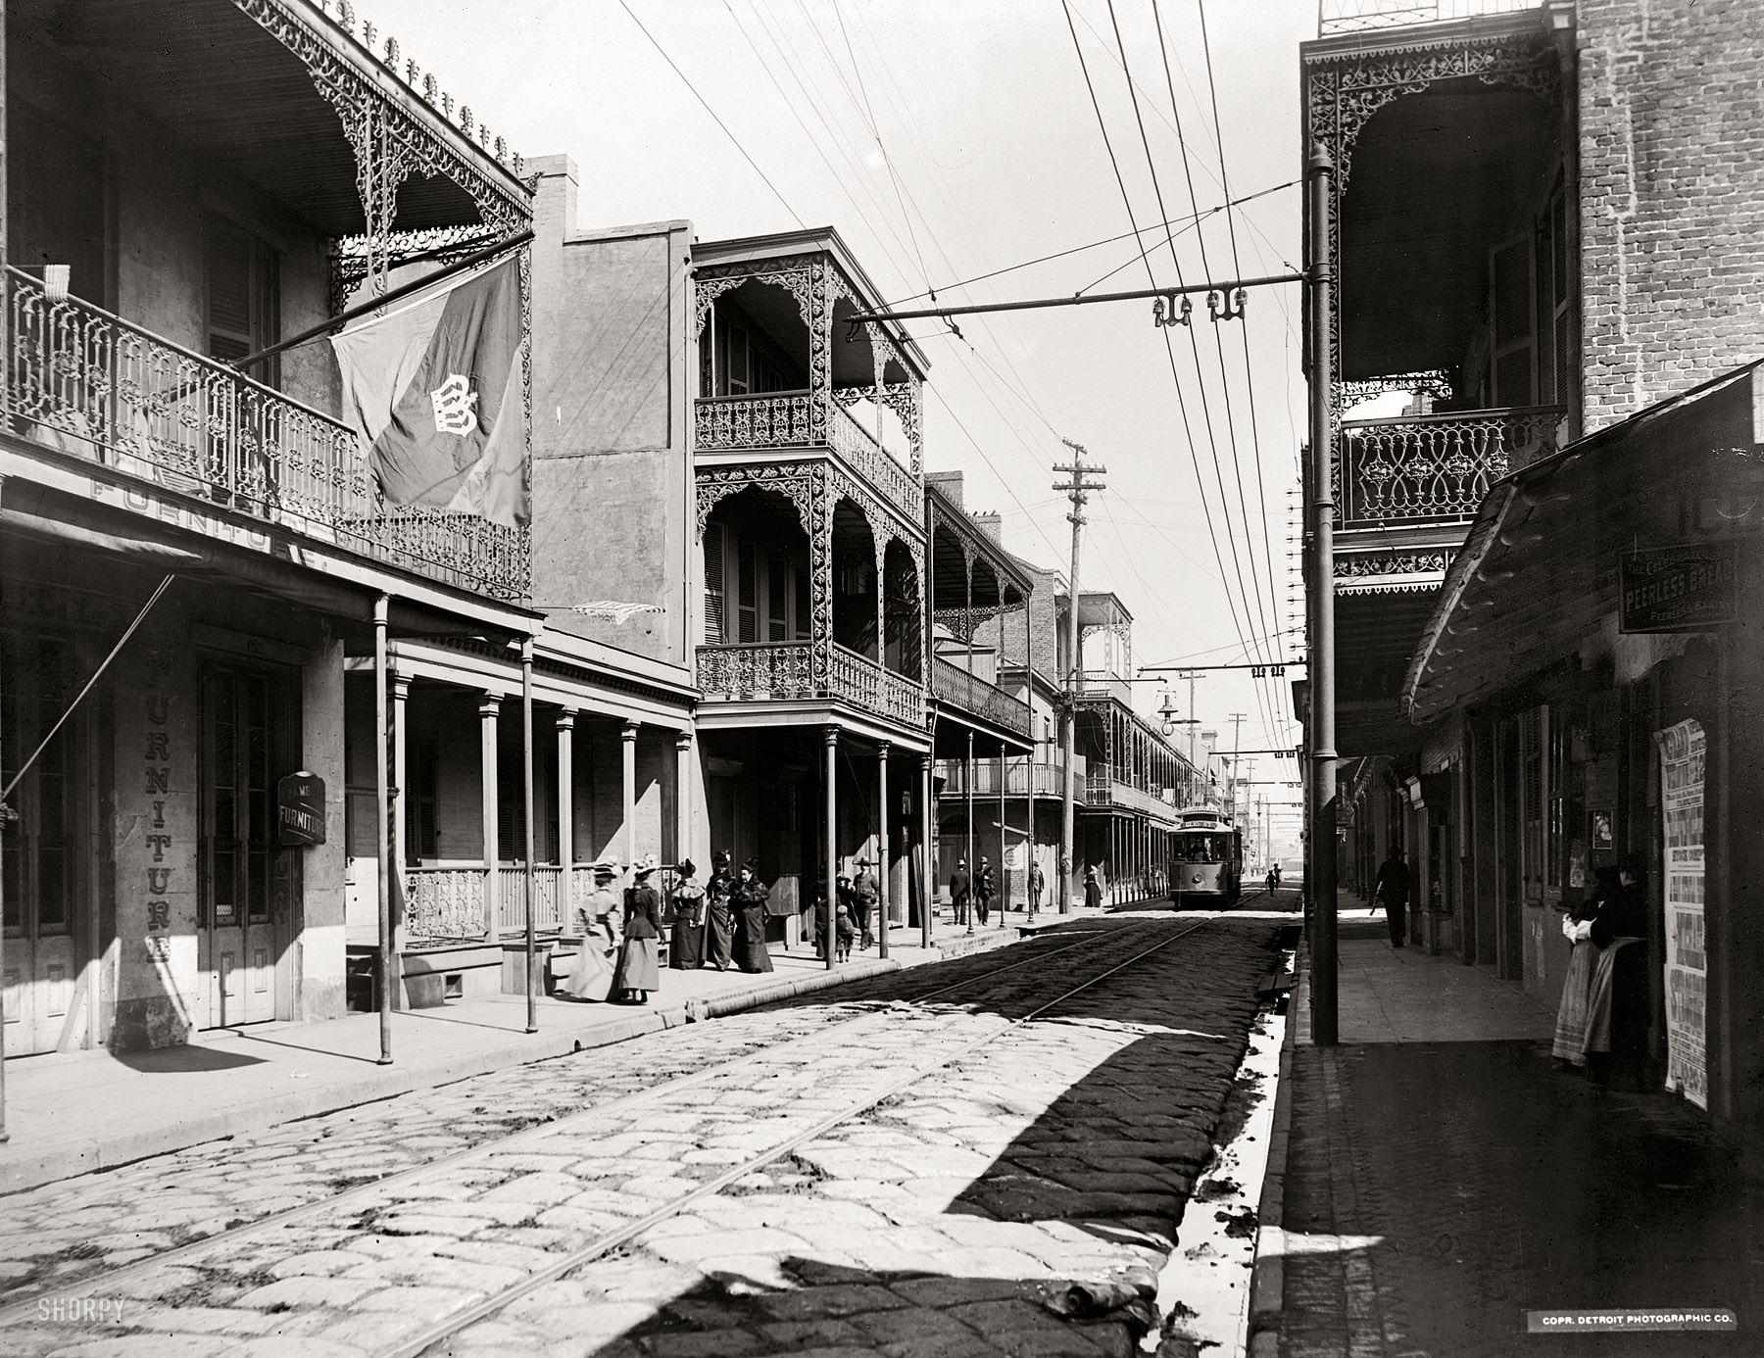
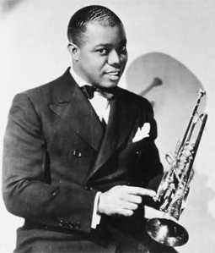
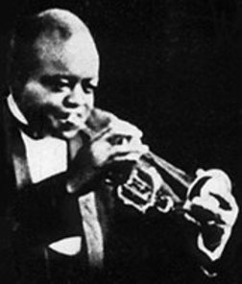
Louis Armstrong/Early Years
Born 8/4/01
His father abandoned the family, he was raised by his mother Mayann
Louis grew up in the bad section of New Orleans known as Storyville (‘the Battlefield’)
At age 7 he began to work for the Karnofsky’s a Russian Jewish family. Mrs. Karnofsky watched over Louis and was an early mentor.
At age 12 he was sent to the Colored Waifs Home, learned to play trpt
1st teacher Peter Davis
Began playing in Joe “King” Oliver’s band, one of the best bands in N.O.
Worked on the steam boats in New Orleans
Young Louis Armstrong
King Oliver

Slide 4
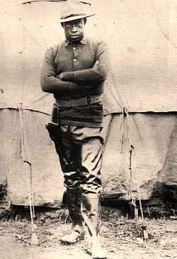
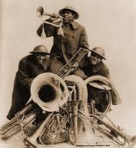
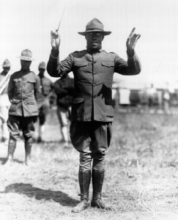
The Hellfighters Band
James Reese Europe
1st all black army regiment in the WWI
James Reese Europe was the regiments band leader
James Reese Europe was a well known and classically trained musician from NY
James Reese Europe was the 1st black officer to see action in the war
The Hellfighters band toured Europe steading this new American music
The Hellfighters band received a hero's welcome when then returned to the USA
James Reese Europe was stabbed by a member of his band and died

Slide 5
KU KLUX KLAN
In the year of 1919, white mobs killed dozens of blacks, some of them returning soldiers in uniform.
The NAACP (National Association for the Advancement of Colored People) organized a national crusade against lynching.
A Billie Holliday song entitled, ‘Strange Fruit’ addressed the issue of lynching
https://www.youtube.com/watch?v=h4ZyuULy9zs
Do you know of any songs that reflect injustices in society today, or addresses political issues?

Slide 6
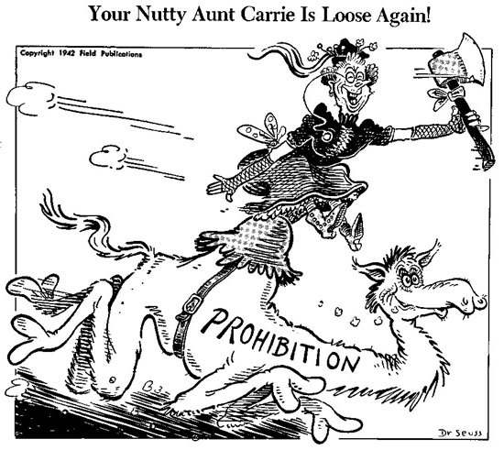
Prohibition
Prohibition 1919-1933
Manufacturing, Sales, and Transportation outlawed
‘The Roaring 20’s’
Demand for illegal alcohol increases, supplied by outlaws
Many illegal speakeasies open up many wanting live music
There became a larger demand for Jazz Music (‘Prohibition was the best thing that happened to Jazz’)
Dr. Seuss was a political cartoonist on prohibition !!

Slide 7
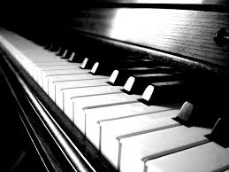
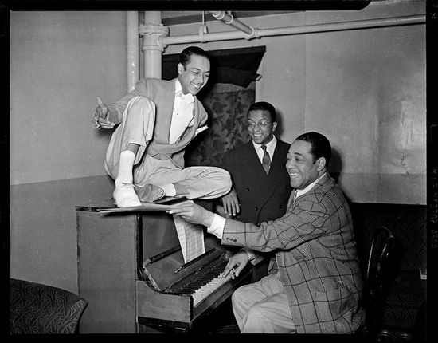
Edward Kennedy Ellington “Duke”
Born in Washington DC to a middle class family
Studied piano at a young age
Somewhat a mommies boy as a child
Was taught race pride at a young age
Always carry yourself with class
Has a wild side during his early teen years

Slide 8
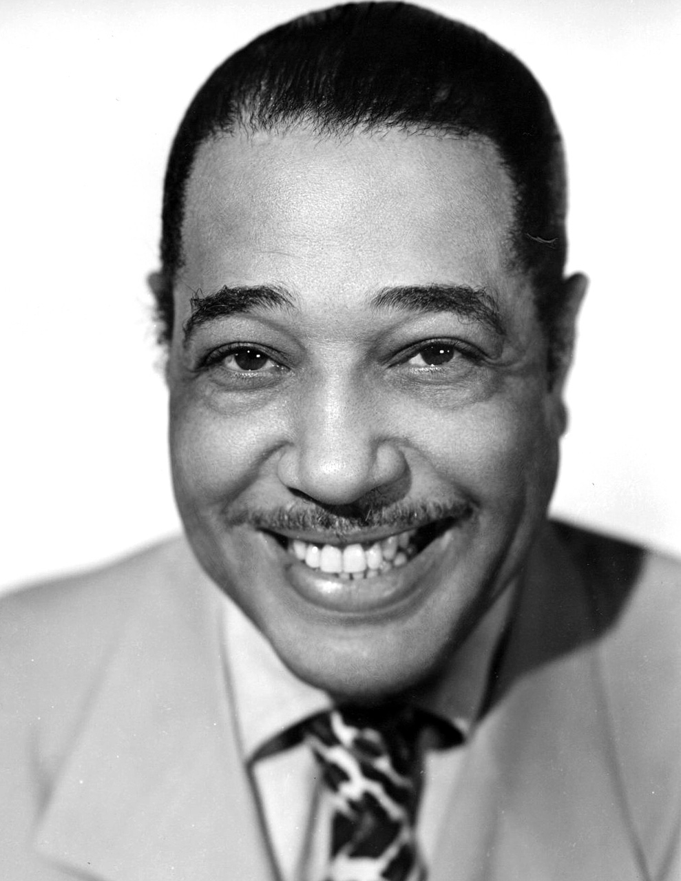
Duke Ellington
Wrote his first song The Soda Fountain Rag
Forms a successful Washington society band playing for white functions
Grows bored with society music and he wants more
Hears the New Orleans sound and wants to play music like that

Slide 9
Louis Armstrong
Called to Chicago to Play in King Oliver’s Band at the Lincoln Gardens
His first recording was Chimes Blues with King Oliver’s Band
Lil pushed Louis to leave Joe King and play 1st Cornet and to be the star!
Louis goes New York to Play for Flecther Henderson

Slide 10
The Harlem Renaissance
The 1920’s was a period of great creativity in the arts for the black community.
Many famous writers ,artists and musicians
All major cities had successful black neighborhoods

Slide 11
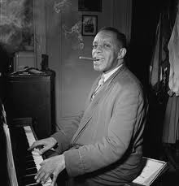
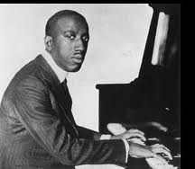
Stride Piano
Stride piano was a popular style of music in Harlem in the 1920’s
The masters of the style were James P Johnson and Willie the Lion Smith
A Cutting contest is when two or more musicians compete to see who plays the best

Slide 12
Duke to NYC
Duke Ellington leave Washington and heads to the Big Apple!
Struggles at first to find works, and learns to play Stride piano and play in cutting contests
Forms is own band and plays at the Hollywood Inn off of Time Sq
The Hollywood Inn is owned by gangsters, it is an illegal club

Slide 13
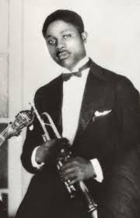
Duke in NYC
Hires James “Bubba” Miley to play his new “Hot Music”
Duke becomes one of the hottest new bands in NYC
Hollywood Inn becomes the Club Kentucky after the owners set the club on fire to collect the insurance
Self -taught

Slide 14
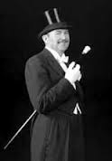
Paul Whiteman
Whiteman is a classically trained musician
Hears Jazz for the first time in San Francisco and becomes excited by the sound
Whiteman wants to” Make a Lady out of Jazz” no improv
Leads the most famous and successful white band of the day, with the best white musicians

Slide 15
The King of Jazz!
The press calls Paul Whiteman the King of Jazz
Whiteman does not make this claims, and he credits many black musicians for this music
Whiteman wanted to hired black musicians for his band, but this would not have been accepted in America

Slide 16
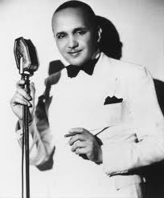
Fletcher Henderson
Classically trained musician with a Masters Degree in Chemistry
Could not find a job in his field and had to played piano to survive in NYC
Formed and Lead the house band at the Rose Land Ballroom, white NYC”s most famous ballroom in Time Sq.
Hired the best black musicians in NYC

Slide 17
Fletcher Henderson
Called the Black King of Jazz
Friends with Paul Whiteman
Wrote arrangements for Whiteman
Many of the best musicians in jazz will at a time play in Henderson’s Band
Brings Armstrong from Chicago to join his band
Good musician but not a great manager of musicians

